Slide 1

Crawford W. Long Middle School
Notes:
Good Evening! Today we begin the process of planning our school’s budget for FY22. I know we are all here for the same reason and that is ensuring success for all (enter school name) students. This meeting is to provide an overview of the draft budget and for you to give feedback on the draft budget.

Slide 2
Norms
This is a meeting of the GO Team. Only members of the team may participate in the discussion. Any members of the public present are here to quietly observe.
We will follow the agenda as noticed to the public and stay on task.
We invite and welcome contributions of every member and listen to each other.
We will respect all ideas and assume good intentions.

Slide 3

GO Team Budget Development Process
YOUR SCHOOL STRATEGIC PLAN…
is your roadmap and your role. It is your direction, your priorities, your vision, your present, your future.
Step 1: Data Review
Step 2: Strategic Plan Review
Step 3: Budget Parameters
Step 4: Budget Choices
Notes:
Today I will provide an overview of the budget allocations for FY22. We will begin the work of funding the strategic priorities we agreed upon during our strategic review meeting. (IF YOU HAVE NOT DECIDED ON YOUR PRIORITIES, YOU WILL SAY – WE WILL DECIDE ON OUR PRIORITIES AND THEN DISCUSS ALLOCATING FUNDS TO ADDRESS THOSE PRIORITIES).

Slide 4
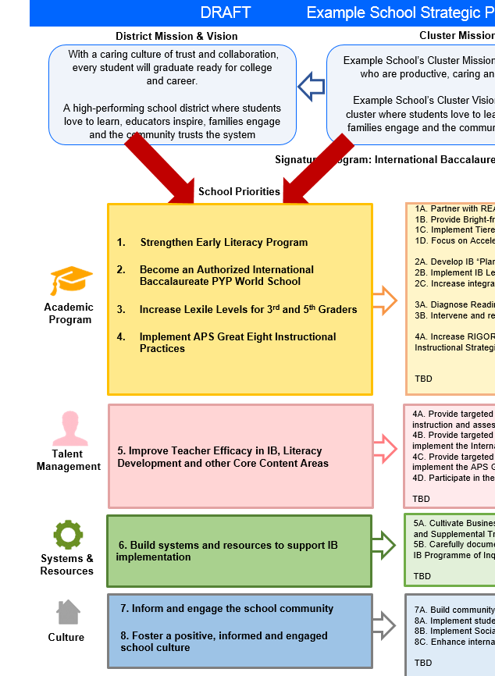
FY22 Budget Development Process
Principal’s Role
Design the budget and propose operational changes that can raise student achievement
Flesh out strategies, implement and manage them at the school level
Focus on the day-to-day operations
Serve as the expert on the school
Hire quality instructional and support personnel
The GO Team’s Role:
Focus on the big picture (positions and resources, not people)
Ensure that the budget is aligned to the school’s mission and vision and that resources are allocated to support key strategic priorities

Slide 5
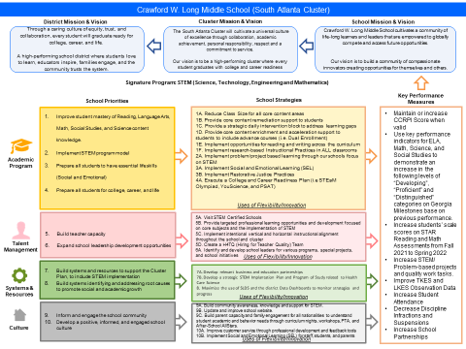

Long Middle School Strategic Plan
Notes:
You should have a copy of our updated strategic plan (please make copies to be distributed to team).

Slide 6
FY22 Priorities & SMART Goals
(From your Strategic Plan, insert your Top 2 Priorities & SMART Goals for FY22 here)
School Priorities
SMART Goals
Academics & Talent Management:
Implement STE(A)M program model to improve student achievement of Reading, Language Arts, Math, Social Studies, and Science content knowledge and exposure to the arts
Increase Reading/ELA, Math, Science, and Social Studies performance on Georgia Milestones and district formative assessments during SY’ 2021-22
Implement two school-wide STE(A)M problem-based learning projects during SY’ 2021-22
Academics & Culture:
Prepare all students to have essential skills for college, career, and life
Enhance perception data on the Georgia School Climate Survey, Culture & Climate Audits, and/or any other surveys during SY’ 2021-22
Utilize YouScience, Georgia Bridge Bill, Everfi, and Second Steps curriculum and/or assessments during SY’ 2021-22
Notes:
Discuss priorities and rationale

Slide 7
FY22 Budget Parameters
FY22 School Priorities | Rationale
Implement STE(A)M program model to improve student achievement of Reading, Language Arts, Math, Social Studies, and Science content knowledge and exposure to the arts | Continue to implement lower class sizes in all core content areas. Dedicated course for students to receive specific interventions and/or enrichment (required by district). Additional Instructional Paraprofessionals will be provided via CARES Funds. Continue consistent STEM and Problem Based Learning Support for staff and students. Ongoing Professional Learning will continue to be provided.
Prepare all students to have essential skills for college, career, and life | Based on the large number of students that have experience trauma and have mental health needs, we will continue with all current wrap around services and SEL.
Notes:
Discuss priorities and rationale. After you have gone over the priorities and rationale – ask GO Team if this represents what was agreed upon.
Are there any priorities I left off?
Are there any questions or concerns?
The next time we meet, I will show you how I have allocated resources to support our strategic priorities.

Slide 8
Discussion of Budget Summary
(Step 4: Budget Choices)

Slide 9
Executive Summary
This budget represents an investment plan for our school’s students, employees and the community as a whole.
The budget recommendations are tied directly to the school’s strategic vision and direction.
The proposed budget for the general operations of the school are reflected at $8,093,190.
This investment plan for FY22 accommodates a student population that is projected to be 753 students, which is a decrease of 67 students from FY21.
Notes:
Here’s a few highlights for our budget this year – read executive summary

Slide 10
School Allocation
Notes:
For FY22, APS is continuing to increase equity within the District and the flexibility principals have in regards to our schools budgeted funds. The new Student Success Funding Model (SSF) allocates dollars to schools based on the number of enrolled students and receives a funding "weight" based on need. This year, student characteristics were weighted based on:
Grade Level –
K-12
Poverty – Weighted for all Direct Certification enrolled students.
Beginning Performance – Weighted Middle School and High School students entering with beginner’s performance on milestones.
ESOL – Weighted for all ESOL designated students in order to supplement due to ESOL staff being locked.
Special Education - Weighted for all Special Education students.
Gifted – Weighted and measured by number of students in the Gifted Program
Small School Supplement – Weighted for low enrollment schools
ES – 500
MS – 600
HS – 700
As you can see, our projected enrollment for FY22 is _______, we increased/decreased by __________ from last year.
We received the following weights for our student characteristics: (Below is just for the script, principals need to insert their school’s characteristics)
Grade Level
Poverty
Special Education
Gifted
Gifted Supplement
ELL
Small School Supplement

Slide 11
School Allocation
Notes:
Additionally, we received money for signature programming, turnaround, Title I and FTE Allotments.

Slide 12
Budget by Function (Required)
Notes:
I am passing out the definitions for these funding categories. You will see what makes up each category. Although the total amount will not change, allocation per function may depending on our conversations and school needs.

Slide 13
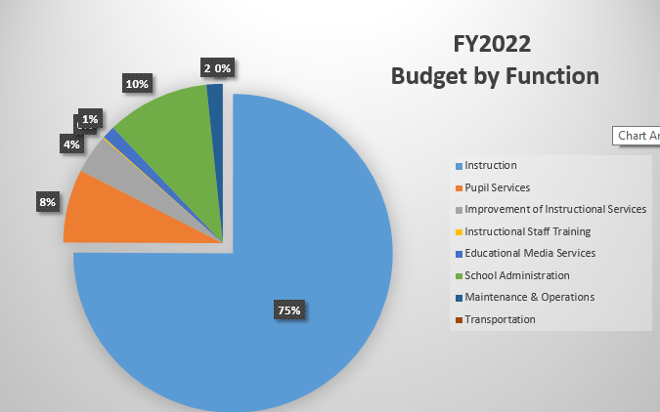
Budget by Function (Required)
Notes:
Explain the pie chart and allocations

Slide 14
What’s Next?
January:
  GO Team Initial Budget Session (Jan. 21st-31st)
February:
  One-on-one Associate Superintendent discussions
  Cluster Planning Session (positions sharing, cluster alignment, etc.)
  Program Manager discussions and approvals
  GO Team Feedback Session
  HR Staffing Conferences (February 23rd - March 5th )
• March:
  Final GO Team Approval (March 5th - March 19th)
Notes:
In February, we will meet again to discuss how the school’s budget has been allocated to support the programmatic needs and FY21 key strategic priorities.
If think we need to continue our budget conversations, we will schedule additional meetings. My goal is to make sure your voices are reflected in our school’s budget.
I will also be meeting with my Associate Superintendent, program managers and other key leaders to go over our budget and to make sure the school is meeting the standards of service and appropriately staffing.
During the week of Feb. 24th -March 2nd , HR Staffing Conferences will be held. At this meeting, I will present my plan for staff utilization, resource distribution and plan for staffing implications.
We will need to approve the budget at the ________ meeting.

Slide 15
Slides to Complete After Initial Meeting and Before You Meet with Associate Supt. And Program Managers

Slide 16
Focus Area Descriptors
Strategic Plan Categories | District Descriptions of Categories
Academic Program | Our students will be well-rounded individuals who possess the necessary academic skills and knowledge and are excited about learning.
Talent Management | We will retain an energized and inspired team of employees who are capable of advancing ever-increasing levels of achievement for students of all backgrounds.
Systems & Resources | We will improve efficiency (productivity, cost, etc.) while also making decisions (including resource allocations) that are grounded in a strategic academic direction and data.
Culture | We will build trust with the community, and we will have engaged stakeholders (employees, students, parents, community members, partners, etc.) who are invested in the mission and vision and who support the creation of student-centered learning communities.
Notes:
I have printed the terms on the next two slides for your convenience. I want to just go over them so we will all be on the same page as we move forward in this process. If you have any questions, please don’t hesitate to ask.

Slide 17
Description of Strategy Categories
Budget Parameters – FY22 funding priorities from the school’s 3-5 year strategic plan, ranked by the order of importance
Strategies – Lays out specific objectives for schools improvement
Request – “The Ask”. What needs to be funded in order to support the strategy?

Slide 18
FY22 Budget Parameters
FY22 School Priorities | Rationale
Implement STE(A)M program model to improve student achievement of Reading, Language Arts, Math, Social Studies, and Science content knowledge and exposure to the arts | Continue to implement lower class sizes in all core content areas. Dedicated course for students to receive specific interventions and/or enrichment (required by district). Additional Instructional Paraprofessionals will be provided via CARES Funds. Continue consistent STEM and Problem Based Learning Support for staff and students. Ongoing Professional Learning will continue to be provided.
Prepare all students to have essential skills for college, career, and life | Based on the large number of students that have experience trauma and have mental health needs, we will continue with all current wrap around services and SEL.
Notes:
Discuss priorities and rationale. After you have gone over the priorities and rationale – ask GO Team if this represents what was agreed upon.
Are there any priorities I left off?
Are there any questions or concerns?
The next time we meet, I will show you how I have allocated resources to support our strategic priorities.

Slide 19
FY22 Strategic Plan Break-out
Priorities | Focus Area | Strategies | Requests | Amount
Improve student mastery of Reading, Language Arts, Math, Social Studies, and Science content knowledge | Academics | Reduce Class Size for all core content areas; Provide core content remediation support to students; Provide a strategic daily intervention block to address learning gaps; Provide core content enrichment and acceleration support to students to include advance courses (i.e. Dual Enrollment) | Two additional Instructional Paraprofessionals (CARES)
Implement STEM program model | Academics | Implement problem/project based learning through our schools focus on STEM | Professional Learning; Materials and Supplies
Prepare all students to have essential life skills (Social and Emotional) | Academics | Implement Social and Emotional Learning (SEL). Implement Restorative Justice Practices | Continue wrap around services and support
Prepare all students for college, career, and life | Academics | Execute a College and Career Readiness Plan (i.e STEaM Olympiad, YouScience, and PSAT)
Build teacher capacity | Talent Management | Provide targeted professional learning opportunities and development focused on core subjects and the implementation of STEM. Implement intentional vertical and horizontal instructional alignment throughout the school and cluster | Professional Learning
Build systems and resources to support the Cluster Plan, to include STEM implementation | Systems and Resources | Develop a strategic STEM Implantation Plan and Program of Study related to Health Care Science
Inform and engage the school community | Culture | Build community awareness, knowledge and support for STEM. Improve customer service through professional development and feedback tools | Hire a Bilingual School Clerk
Develop a positive, informed, and engaged school culture | Culture | Implement Social and Emotional Learning (SEL) for staff, students, and parents
Notes:
For the next few slides, I will show you how I have allocated the budget to support our strategic priorities.
Based on our strategic priorities and funds we received, here is a break-out of the priorities, which focus area it addresses, the strategies that will be implemented, the purchase request, which funding source was used and the amount.

Slide 20
Plan for FY22
Title I Holdback and Family Engagement Funds
Priorities | Focus Area | Strategies | Requests | Amount
Improve student mastery of Reading, Language Arts, Math, Social Studies, and Science content knowledge | Academic Talent Management | Provide core content enrichment and acceleration support to students to include advance courses (i.e. Dual Enrollment); Provide targeted professional learning opportunities and development focused on core subjects and the implementation of STEM. Implement intentional vertical and horizontal instructional alignment throughout the school and cluster | Instructional Coach for Social Studies | $103,054
Notes:
This slides represent the priorities we will fund if we receive additional money from Title I and the Leveling Reserve. When we approve the budget we will approve both so that we will not have to schedule another meeting if the funds are made available.
Before I turn it back over to the Chair for the next slide, I want to thank you for your hard work and support this year. I will keep you informed as we move through the budget process. (Please inform Chair that they will facilitate the discussion for the last slide)

Slide 21
Plan for FY22 Leveling Reserve
Priorities | Focus Area | Strategies | Requests | Amount
Improve student mastery of Reading, Language Arts, Math, Social Studies, and Science content knowledge. | Academics | Provide a strategic daily intervention block to address learning gaps; Provide core content enrichment and acceleration support to students to include advance courses (i.e. Dual Enrollment | Materials & Supplies
Notes:
This slides represent the priorities we will fund if we receive additional money from Title I and the Leveling Reserve. When we approve the budget we will approve both so that we will not have to schedule another meeting if the funds are made available.
Before I turn it back over to the Chair for the next slide, I want to thank you for your hard work and support this year. I will keep you informed as we move through the budget process. (Please inform Chair that they will facilitate the discussion for the last slide)

Slide 22

Questions?
Thank you for your time and attention.
Notes:
IF YOU FEEL YOUR TEAM IS READY TO APPROVE THE DRAFT BUDGET, PLEASE DO SO. PLEASE REMIND THEM THAT YOU MAY NEED TO MEET WITH THEM AGAIN, IF THERE ARE CHANGES FROM YOUR MEETINGS WITH DISTRICT LEADERSHIP. LET THEM KNOW YOU WILL KEEP THEM INFORMED!!

